Slide 1
BHARTI INFOTECH AND SERVICES
Bilaspur , Chhattisgarh
Introduction to Motor Shield

Slide 2
Motor Shield
Adafruit designed a very useful shield (in 2008 ?), called "Adafruit Motor Shield". It was (is) a useful shield with older components.
In 2014, Adafruit has a discontinued this shield and has a new and much better motor Shield. This page is only here for the old shield, and for the clone boards.
The shield contains two L293D motor drivers and one 74HC595 shift register. The shift register expands 3 pins of the Arduino to 8 pins to control the direction for the motor drivers. The output enable of the L293D is directly connected to PWM outputs of the Arduino.
To increase the maximum current, the L293D allows extra chips with "piggyback". Piggyback is soldering one or two or three extra L293D drivers on top of the L293D drivers on the board to increase the maximum current. The L293D allows parallel operation.
The Motor Shield is able to drive 2 servo motors, and has 8 half-bridge outputs for 2 stepper motors or 4 full H-bridge motor outputs or 8 half-bridge drivers, or a combination.
The servo motors use the +5V of the Arduino board. The voltage regulator on the Arduino board could get hot. To avoid this, the newer Motor Shields have connection points for a separate +5V for the servo motors.

Slide 3
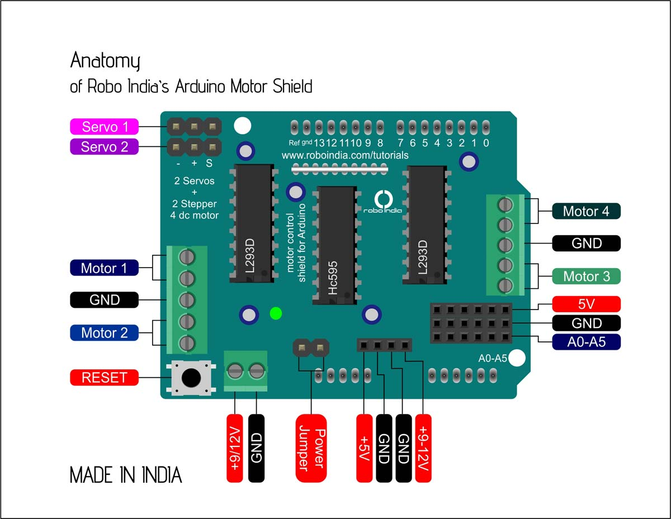

Slide 4
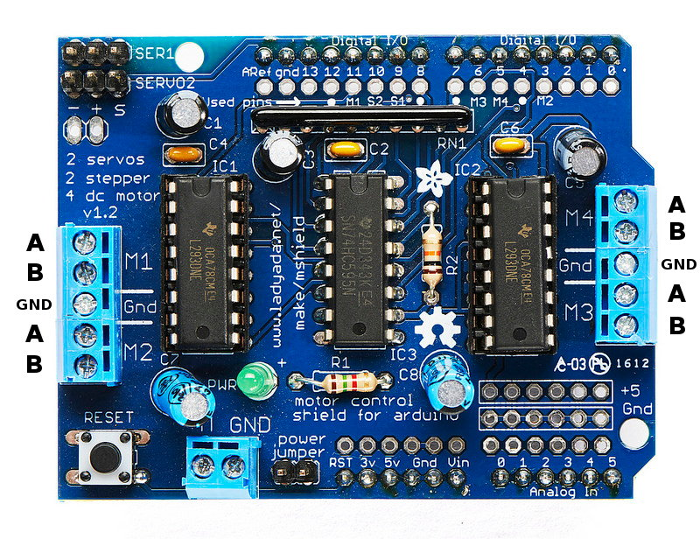
Introduction to L293D Motor Shield
L293D is a Motor driver IC used to control motors with a microcontroller. This motor shield consists of three IC’s. We can control 4 motors with the shield so there are two L293d Ic’s used. The motor shield is used for (Arduino Uno) board.This shield can control servo’s, Dc motors and stepper motors. The two chips of L293D can control four motors with 0.6 A per bridge. The best thing about the shield is we don’t need to write the whole function for driving a motor there is
a special library for this module.we just recall some commands to run the motor.

Slide 5
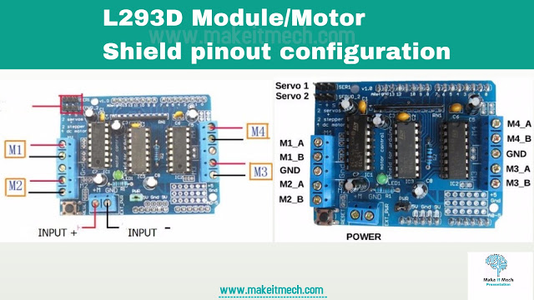
L293D Motor Shield Pinout Configuration
Here is the Pinout Configuration of the Module. Install the shield first on Arduino board and check everything that works fine. The four pins for Dc motors on Left and Right side. We can also connect stepper motors on these pins.
The Motor driver shield comes with 600 mA per motor and 1.2 A peak current.
The motors can be controlled from 4v to 25 volts.

Slide 6
Features:
Operating Voltage: 4.5 to 12V
Continuous Output Current: 1.2A
Logic control voltage Vss: 4.5~5.5
Arduino Motor Shield
The Arduino Motor Shield allows you to easily control motor direction and speed using an Arduino. By allowing you to simply address Arduino pins, it makes it very simple to incorporate a motor into your project. It also allows you to be able to power a motor with a separate power supply of up to 12v. Best of all, the shield is very easy to find. For all of these reasons, the Arduino Motor Shield if a cool little to have in your arsenal for rapid prototyping, and general experimenting.

Slide 7
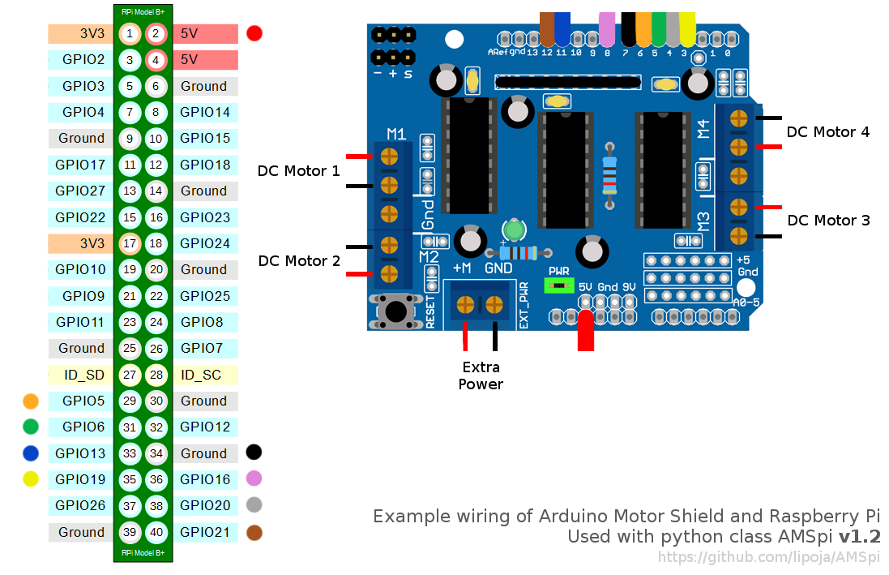
Arduino Motor Shield L293D with Raspberry Pi B+ (part 2)

Slide 8
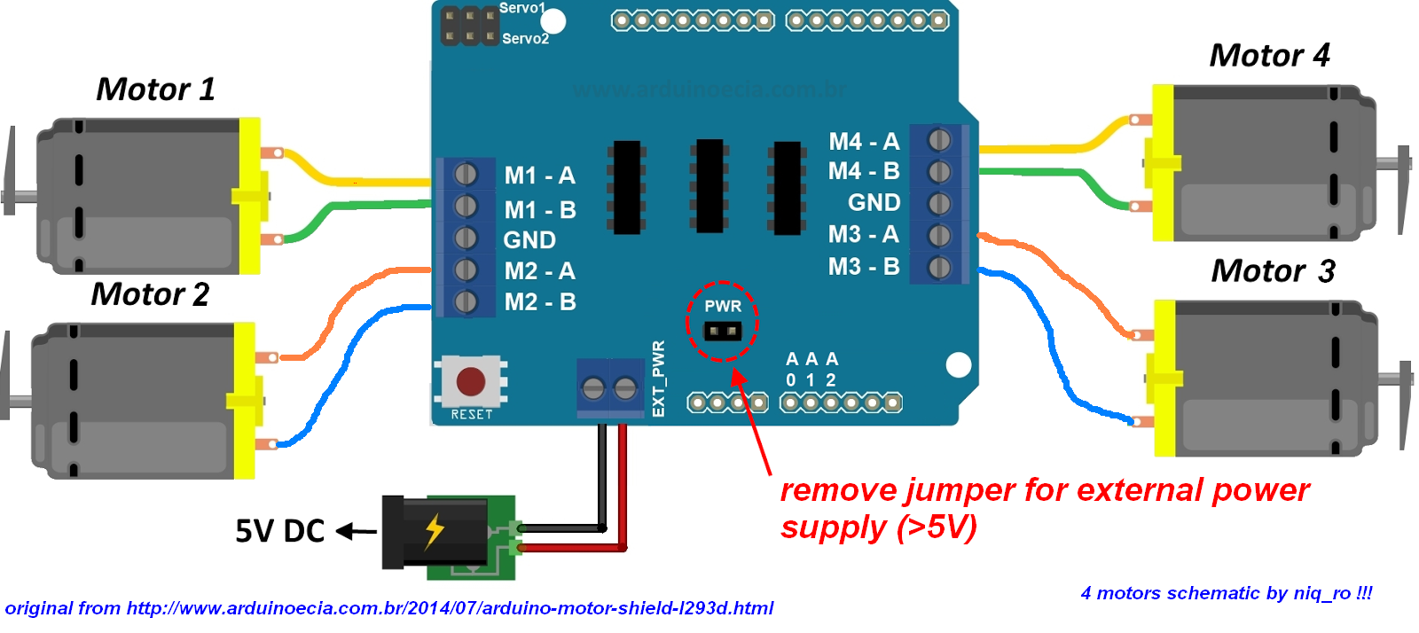
Connect Motor with Motor Shield

Slide 9
Features:
• 2 connections for 5V 'hobby' servos connected to the Arduino's high-resolution dedicated timer - no jitter!
• Up to 4 bi-directional DC motors with individual 8-bit speed selection (so, about 0.5% resolution)
• Up to 2 stepper motors (unipolar or bipolar) with single coil, double coil, interleaved or micro-stepping.
• 4 H-Bridges: L293D chipset provides 0.6A per bridge (1.2A peak) with thermal shutdown protection, 4.5V to12V • Pull down resistors keep motors disabledduring power-up
• Big terminal block connectors to easily hook up wires (10-22AWG) and power
• Arduino reset button brought up top
• 2-pin terminal block to connect external power, for separate logic/motor supplies
• Tested compatible with Mega, UNO& Duemilanove
• Dimensions: 69mm x 53mm x 14.3mm (2.7in x 2.1in x 0.6in)

